Slide 1


Polarization camera toolbox
By - Kartikey Rathi

Slide 2

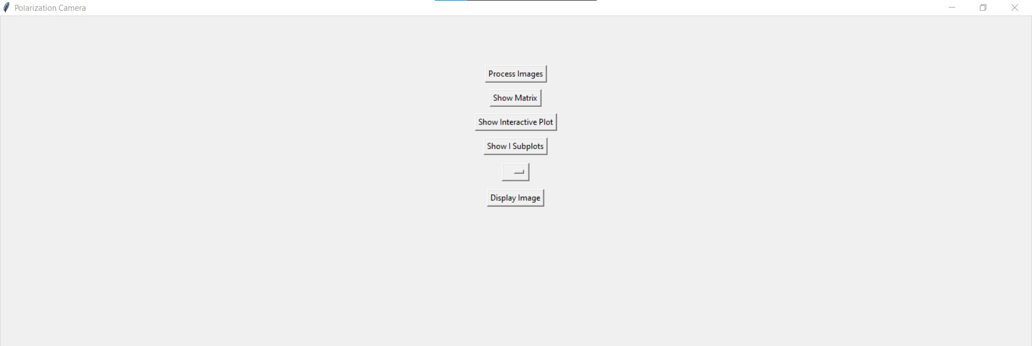
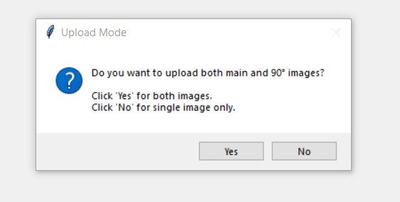
Opening Interface
Step 1 : Click Process images button.
Rest all buttons are disabled without this.
New terminal openend after clicking “Process Images”
By Kartikey Rathi

Slide 3
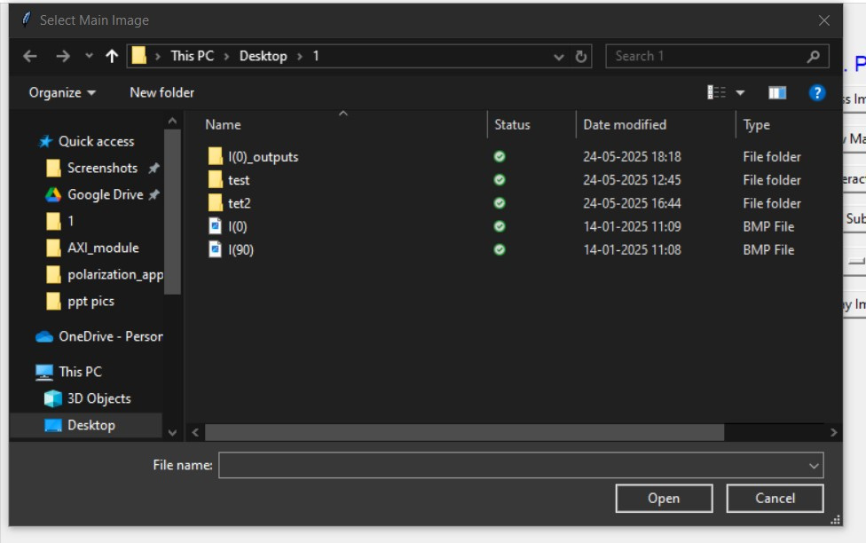
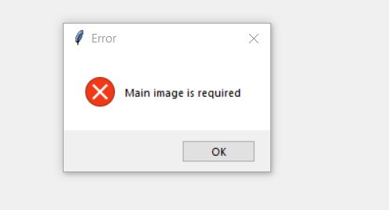
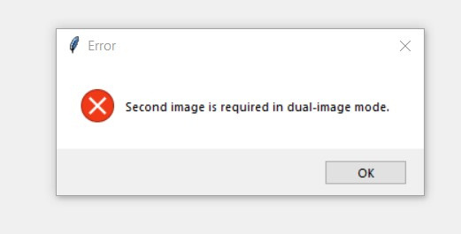
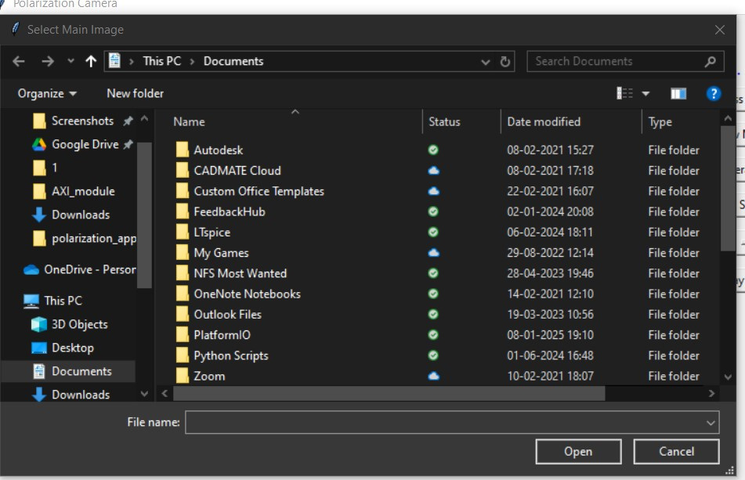
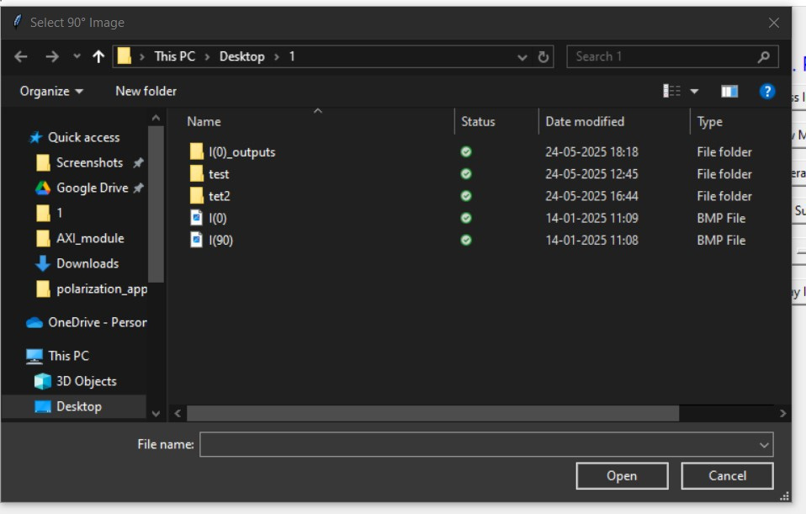
Single image upload option
Click “No” for 1 shot capture upload
File selection option will appear once
Error window if failed to upload image
Click “Yes” for 2 shot capture upload
File selection option will appear twice.
Error window if failed to upload image
Error window if failed to upload image
Upload Main image(Without the QWP)
Upload 2nd image(With the QWP)
By Kartikey Rathi

Slide 4
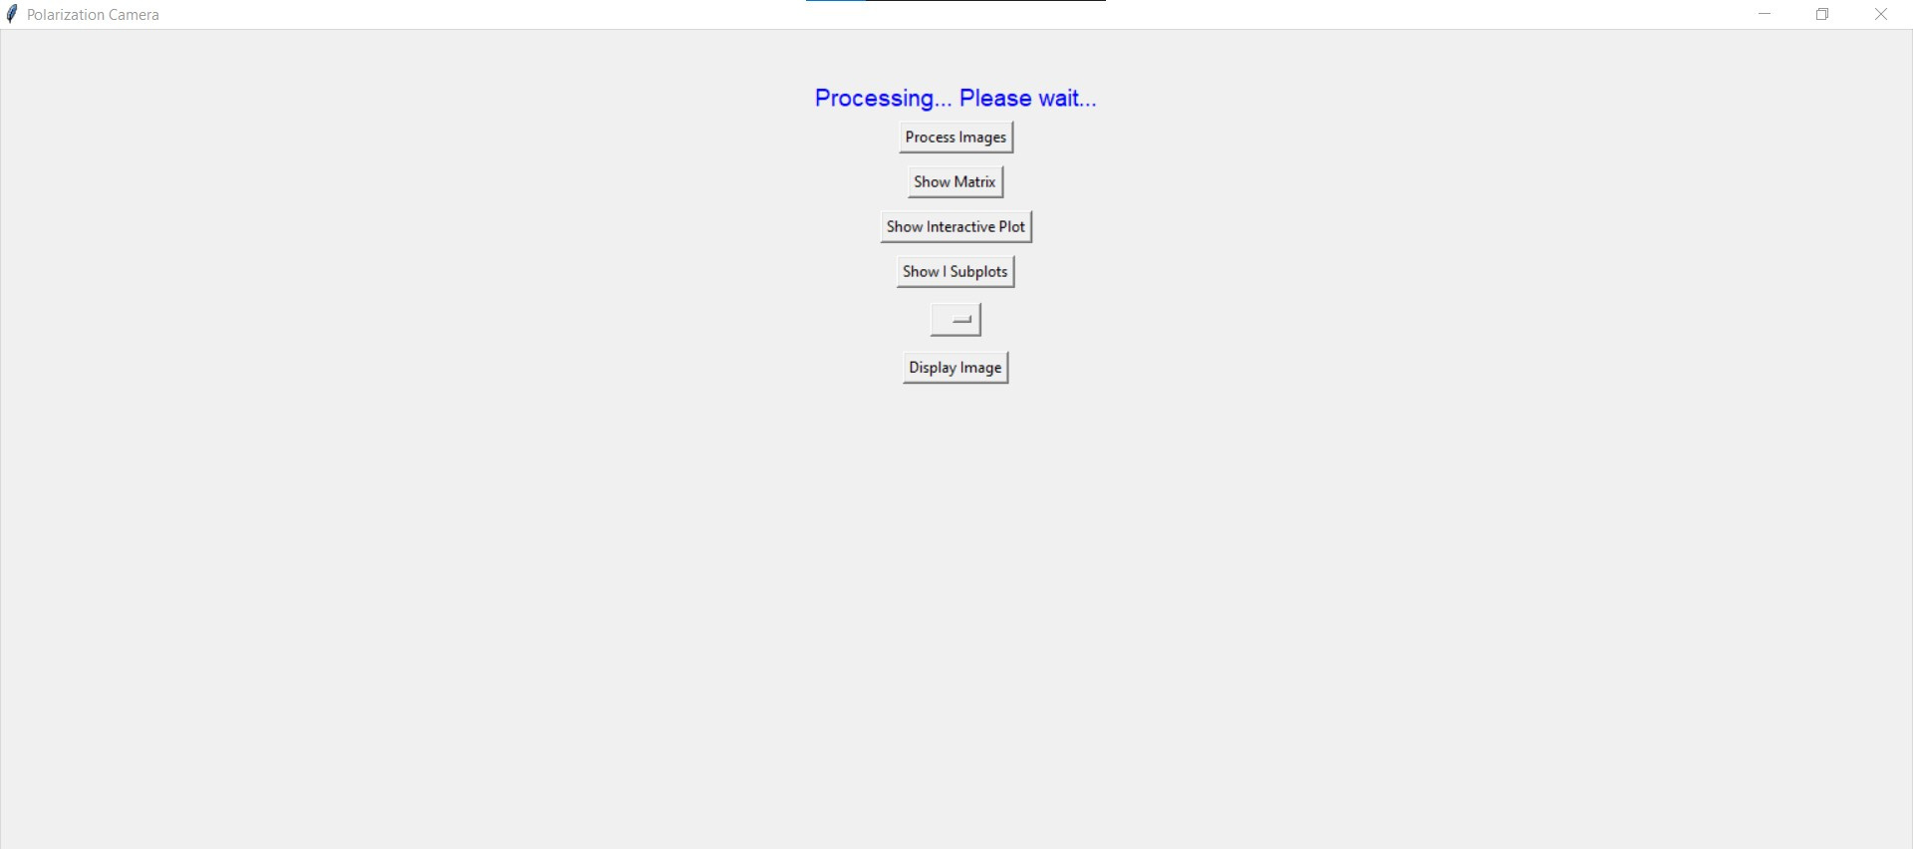
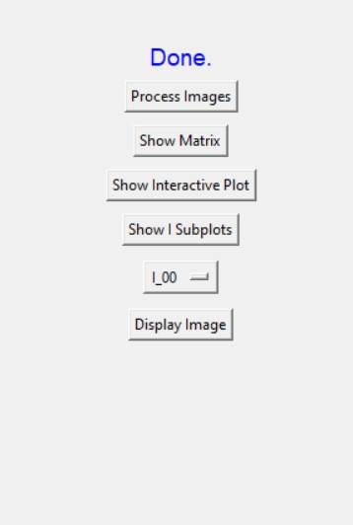
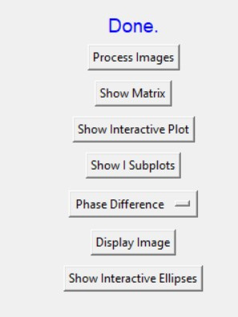
Processing window
Processing completed
Processing completed
the polarization ellipse plot can only be seen when both the datas are taken
Single image uploaded
Two image uploaded
By Kartikey Rathi

Slide 5
1. Can be selected again to process a new set of data
3. Opens an excel file with the data of the selected parameter
4. Opens a html file of the selected parameter with interactive features
5. Shows the .bmp files’ data used for processing and giving results
2. Gives a drop down menu for the options of plots/matrices (parameters)
6. Opens the heatmap of selected paramter (non interactive)
7. Gives ellipse plots corresponding to various pixels of the data.
By Kartikey Rathi

Slide 6
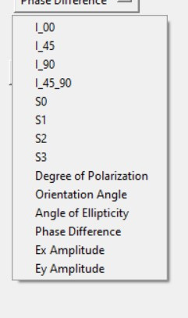
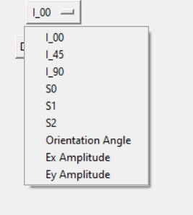
2. Drop-down menu options(parameters)
Single shot upload
Double shot upload
By Kartikey Rathi

Slide 7
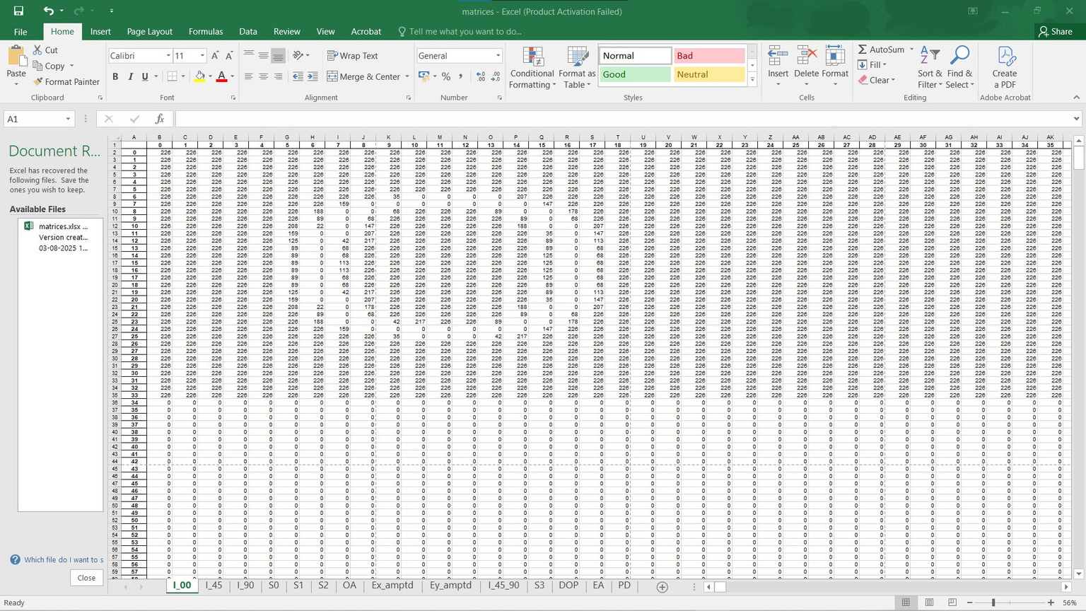

3. Show matrix (opens excel file)
Single shot upload options
Double shot upload options
By Kartikey Rathi

Slide 8
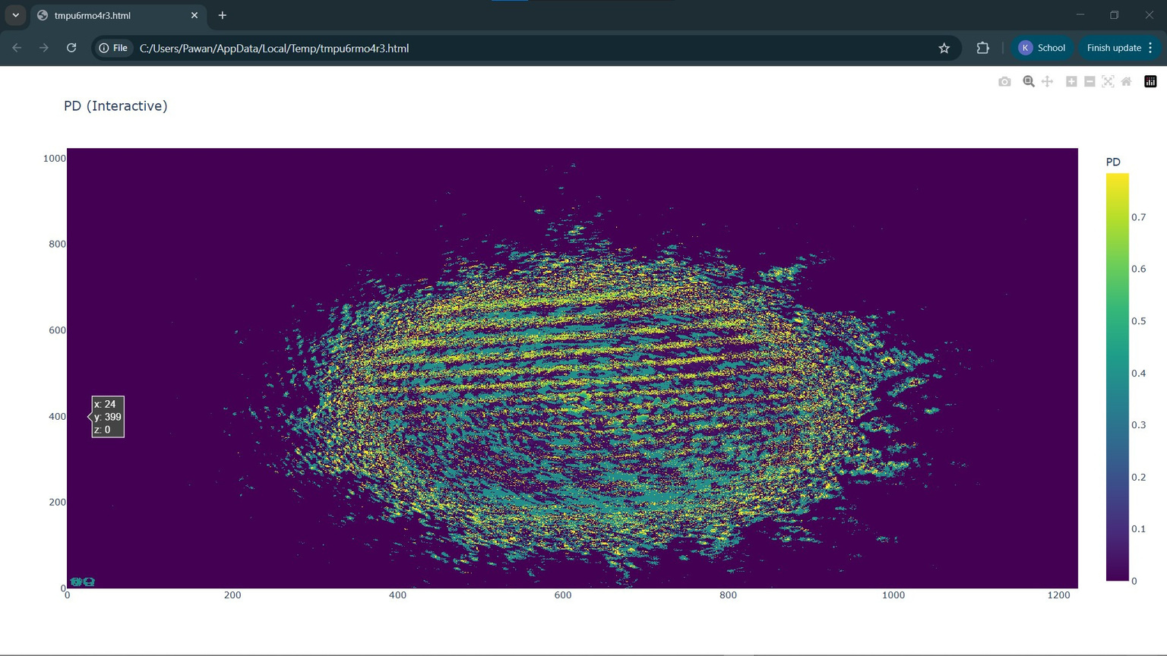
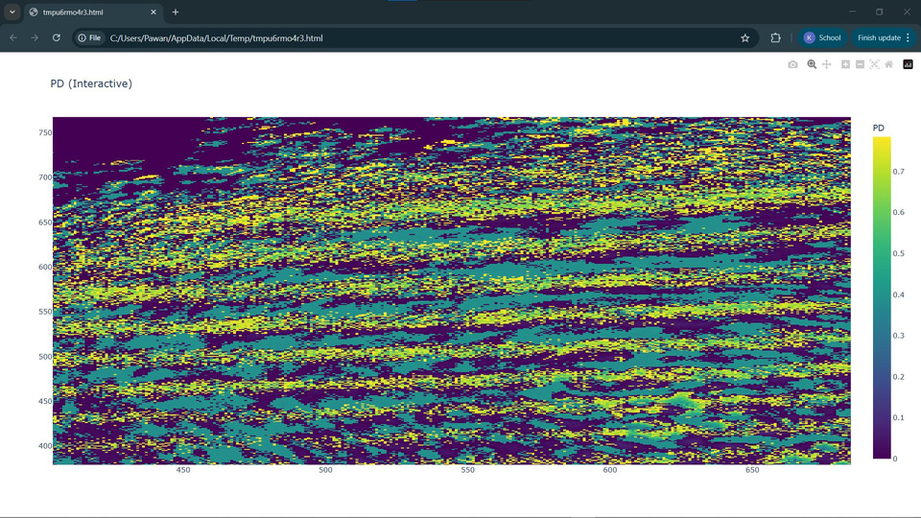
4. Show interactive plot (opens .html file)
a portion of the interactive plot can be zoomed and value at a particular (x,y) can be viewed
By Kartikey Rathi

Slide 9
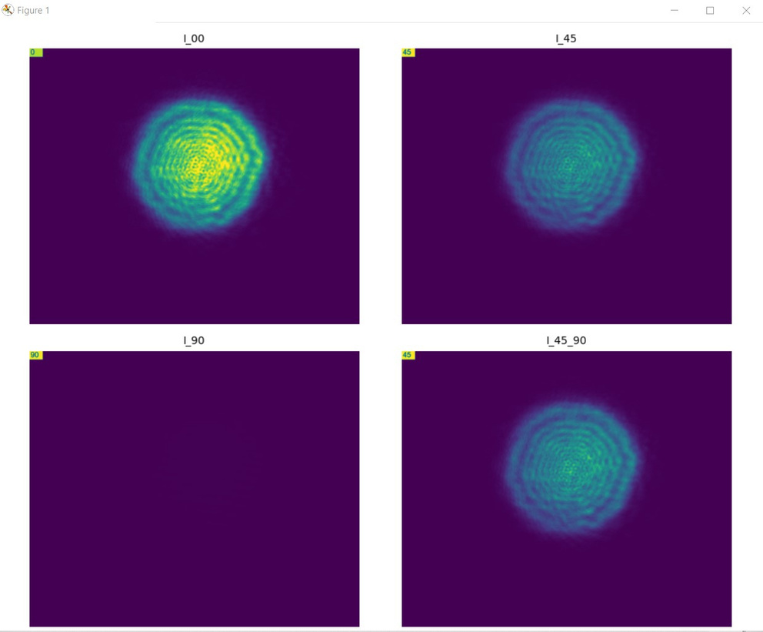
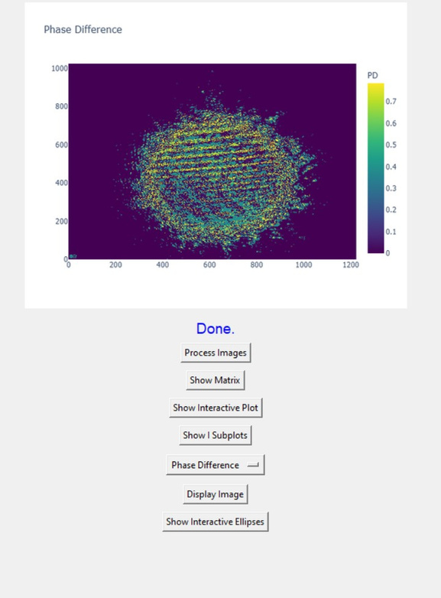
5. Show I_subplots
6. Display Image(shows image in the terminal)
By Kartikey Rathi

Slide 10
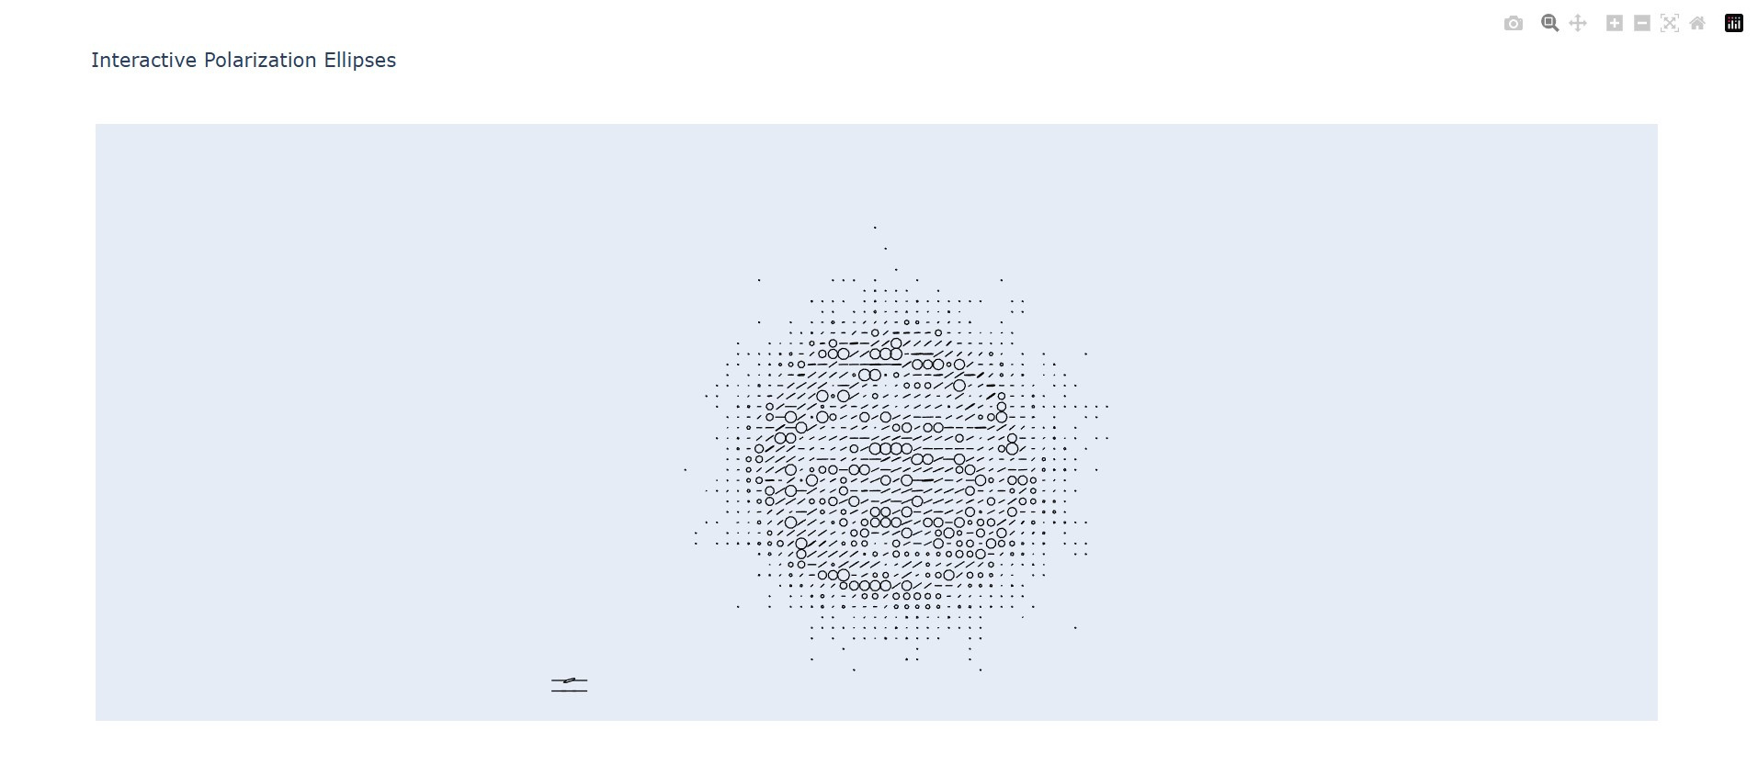
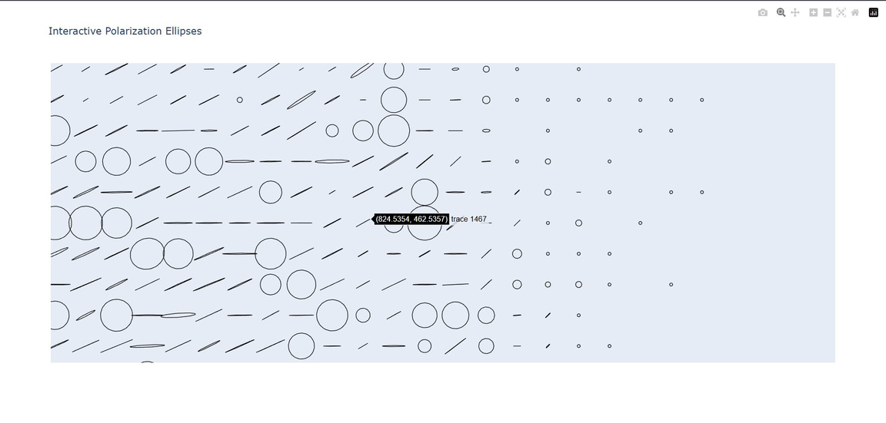
7. Show interactive ellipse plot
(shows ellipse plots which can be zoomed and viewed at particular points)
By Kartikey Rathi

